Slide 1
Using Sonar cloud with maven

Slide 2
Context
This document contains the steps to run code analysis for your project with the help of SonarCloud
Requirements
Maven installed on your local machine
GitHub account

Slide 3
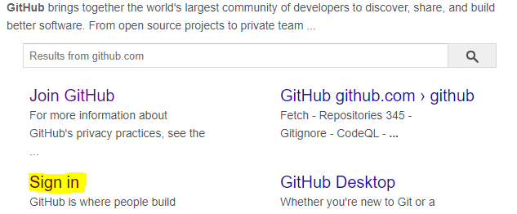
Step 1 : Sign up in git to create your git account.

Slide 4
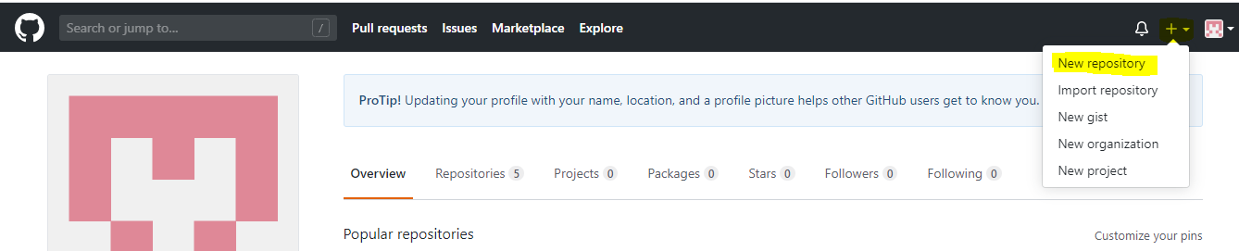
Step 2 : After creation of your account when you login into your account.
Create a repository in Git (refer the below image)

Slide 5
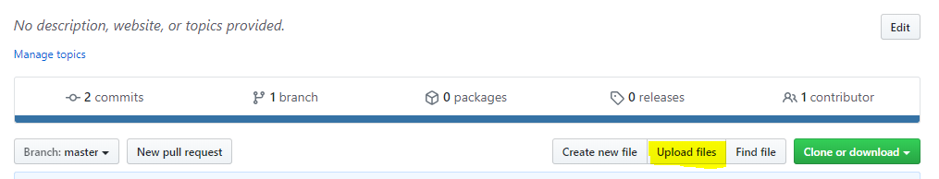
Step 3 : Upload the source(src) folder of the project and pom.xml file

Slide 6
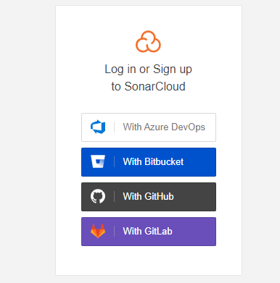
Step 4 : Go to sonarcloud.io and signup in SonarCloud using your GitHub account

Slide 7
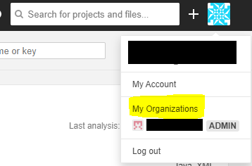
Step 5 : Click on your profile in the page and click on "My organization"

Slide 8
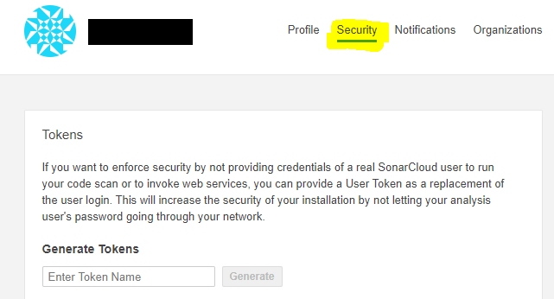
Step 6 : Select security tab and generate a security token by giving any name to the token
(Keep the token number for your reference)

Slide 9
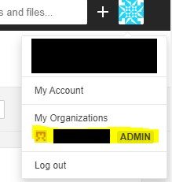
Step 7 : Create the maven build command as follows:
mvn clean package sonar:sonar -Dsonar.host.url=https://sonarcloud.io -Dsonar.organization=<your organization name in sonar> -Dsonar.login=<the security token>
For organization key go to the dashboard and after you click on your profile present at the top right corner click on the organization that you had created. (refer the below image)

Slide 10
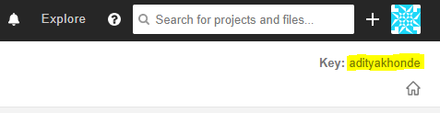
Step 7 : Create the maven build command as follows: (Continued)
You will be able to see the key after that at the top right corner
Your command will look similar to the below:
mvn clean package sonar:sonar -Dsonar.host.url=https://sonarcloud.io -Dsonar.organization=adityakhonde -Dsonar.login=7d1144c59abf6dsdsde232813c431ad33f6d0d

Slide 11
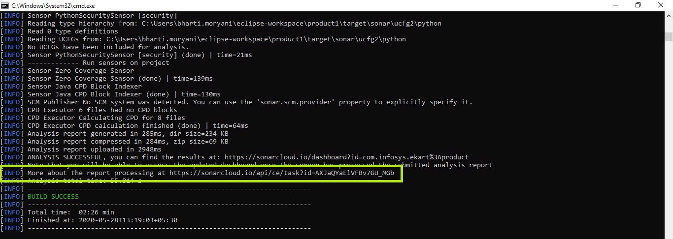
Step 8 : Now browse to your project file directory and open command prompt from there and run the created command.
Maven will start to build the project. After successful build it will give you the sonar URL which will contain the detailed analysis report.

Slide 12
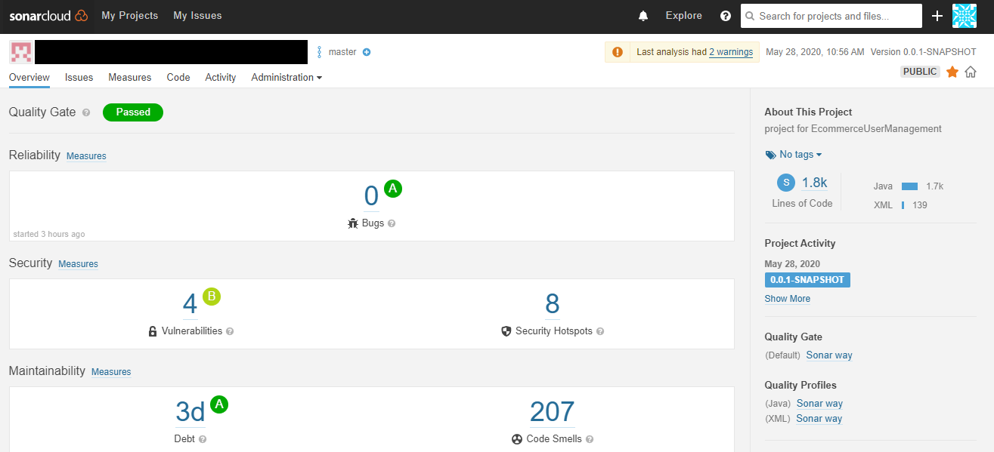
Step 8 : Go to the URL for the detailed analysis of your project.

Slide 13
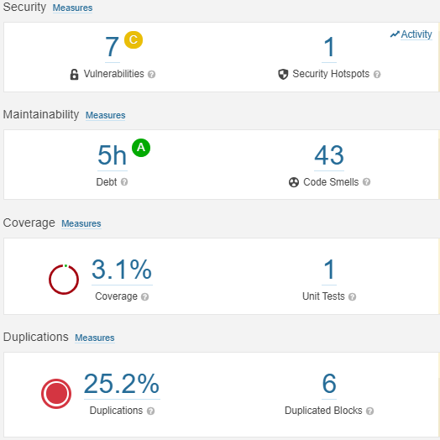
Guidelines for analysis of your project.
Factors which can be ignored for now:
Vulnerabilities - Refactor this code to not construct the URL from tainted, user-controlled data.
Code Coverage
Code smells -
Removing the unused import.
Removing the commented out code.
Renaming the package name to match the regular expression.
Code Grades guidelines:
Code Duplication factor should be in range 20-30%.
Maintainability should not exceed B grade.

